Slide 1
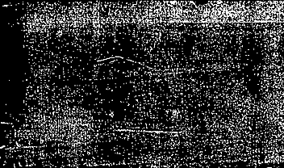
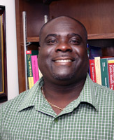

The Willingness to Prevent Obesity via Text Messaging among Low-Income African Americans Living in Single-Family Homes
Author: Edward V. Wallace
Presented by La’neir Haines-Hughes

Slide 2

synopsis
Racial and ethnic minority populations are disproportionally affected by obesity.
Text messaging is a major feature of mobile phones and is popular because it allows people to receive information effectively, unobtrusively, and privately.
Examine low-income African Americans’ willingness to prevent obesity by receiving mobile phone text messaging.

Slide 3

“Let’s get started”
University of Cincinnati Recreational Center
Focus group interviews (40mins long + $25 gift card afterwards)
5 focus groups of 30 participants (Equally male & female)
Low-income African American adults aging 31 - 34 years of age living in single family homes.
10-week sustainable obesity medication program.
One researcher was responsible for conducting group discussion while taking notes and the other observed and transcribed participants verbal communication and nonverbal cues
The same two researchers conducted all five focus groups to maintain consistency.
Open coding proceeded.
Notes:
Qualitative Data Analysis = Open coding is achieved by segmenting data into meaningful expressions and describing them in single words or short sequence of words.

Slide 4
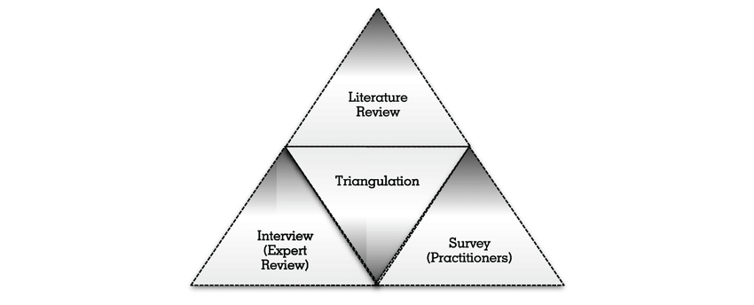

Triangulation

Slide 5
Health belief model!
#TheoreticalFramework
Concept | Definition | Application
Perceived Susceptibility | Chances of getting the condition. | Define population(s) at chances getting a risk, risk levels condition.
Perceived Severity | How serious is the condition. | Specify consequences of the risk and condition.
Perceived Benefits | “Is this really worth it?” Why/why not? | Define action to take: the efficacy of the how, where, when.
Perceived Barrier | How adverse the “road to be healthy” is perceived to be; mental/physical cost. | Identify and reduce barriers the tangible and through reassurance, psychological cost incentives, assistance
Cues to Action | “How am I going to go about this venture?” | Provide how-to information promote awareness; reminders.
Self-Efficacy | “Can I do this?” | Provide training.

Slide 6

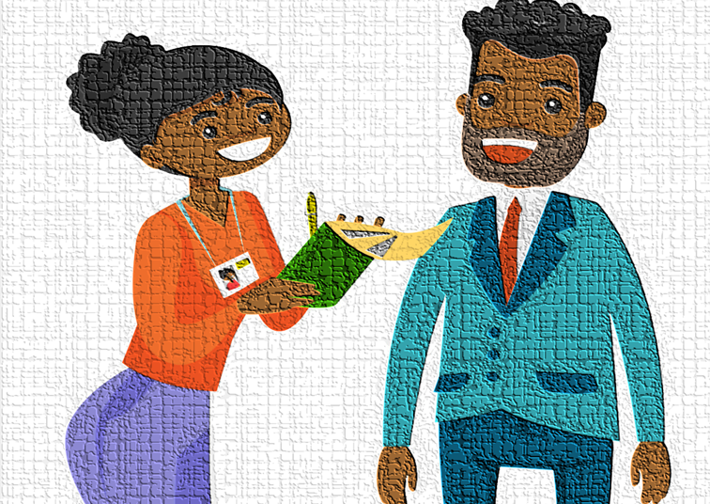
#Open-ended ?’s
“Do you believe that being physically inactive or eating poorly puts African Americans at risk for becoming obese or decreases their quality of life. If so, why?” (perceived susceptibility)
“Do you believe there are health consequences for African Americans if they are not physically active or eating healthy? Why or why not?” (perceived seriousness)
“How confident do you feel you can reduce your obesity and what can be done to help you be physically active and eat right”? (self-efficacy)
“What techniques, strategies, or tools can motivate you to prevent obesity?” (cues to action)
Notes:
Qualitative Data Analysis = Open coding is achieved by segmenting data into meaningful expressions and describing them in single words or short sequence of words.

Slide 7

Health Belief Model (based text Messages)
Questionnaire:
Monday
Wednesday
Friday
Notes:
Monday discussions were focused around text messaging, perceived susceptibility and perceived seriousness.
Wednesday, the discussions focused on text messaging and self-efficacy
Friday the discussions generally emphasi]ed cues to action and text messaging

Slide 8
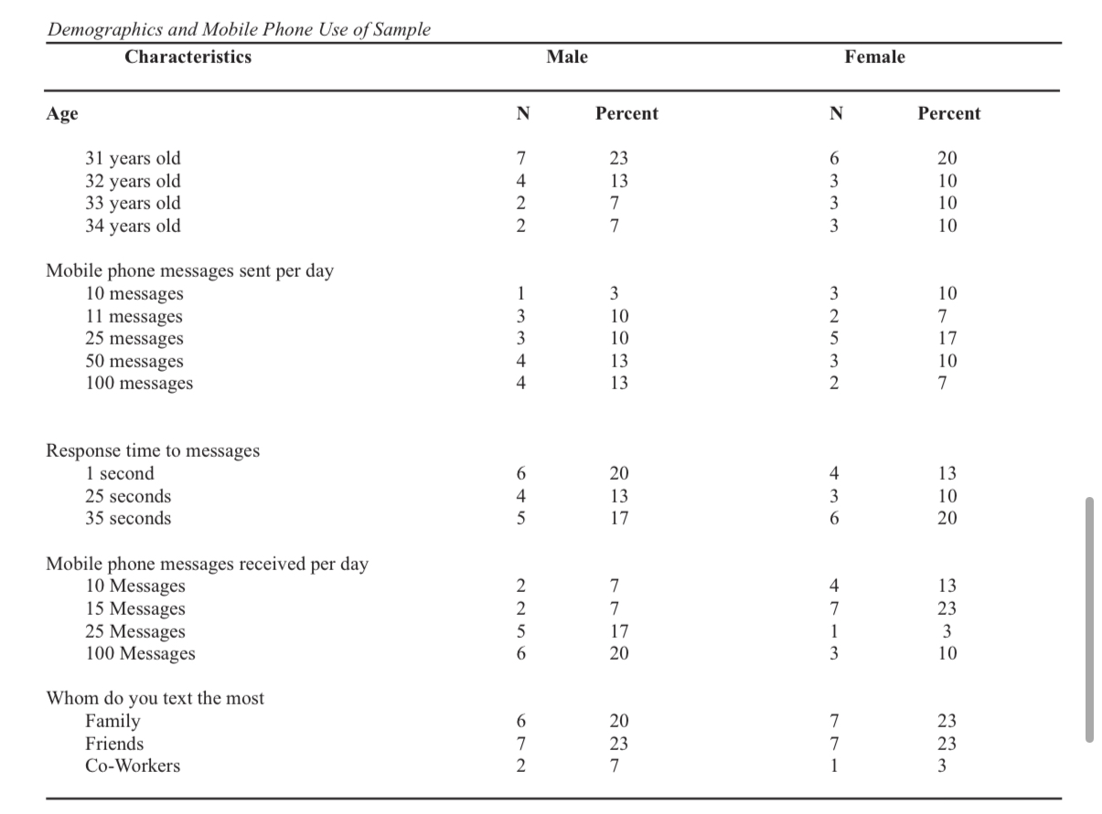
results
All participants displayed excitement.
Most people sent texts to family.
Send 45 messages a day
Receive 40 messages a day
Left on read 5 times a day?**

Slide 9
Health belief model!
Concept | Outcome Affecting | Results
Perceived Susceptibility | Obesity awareness | 96% “It’s a good idea if they received text messages asking about if they ate poorly and if they exercised daily.”
Perceived Severity | Increase physical activity African Americans if they are not physically active Increase fruit & vegetable or eating healthy? intake to maintain a healthy weight | 83% believed that receiving warnings via text messages about possible health issues helped.
Cues to Action | Increase confidence to and what can be done to help you be physically active exercise more often and eat right to reduce obesity | 83%, 63%
Self-Efficacy | Increase physical activity to prevent obesity? to prevent obesity Decrease foods high in fat to prevent obesity Increase fruit & vegetable intake to maintain a healthy weight | Males – 3 & Females - 2
#Discussion
#Results
Notes:
Perceived Susceptibiility - ³As African Americas we are constantly stressed so we don’t need tons of text messages everyday, we already know we are susceptible to becoming obese in our community.”

Slide 10
Discussion (continued)
Four key theoretical constructs (perceived susceptibility, perceived seriousness, self-efficacy, and cues to action)
Generally, African Americans found it beneficial to receive text messages checking if they ate healthy/exercised.
Lile Mistry's study in 2015, there’s an abundance amount of evidence that supports the notion that texting has a major impact on people that want to engage in exercise during their workday.
Aspirations like traveling the world, playing with grandchildren.
African American men feel that being obese can affect their financial status.

Slide 11

“Let’s turn the table to you all”
What are some limitations that you found in this study? (If any)
Do you use your cell phone (apps, social media, notes, etc.) as a tool to contribute to your physical and mental health?
How would you approach a 30+ year old family member about their physical health if they appeared to be on a downward spiral health-wise?

Slide 12

THANK YOU

